Slide 1


Idea Valuation: Framework for Valuation of the Commercial Prospects of an Idea
Dr. S. K. Majumdar

Slide 2
Ethos of Entrepreneurship
Entrepreneurship is Learning to Disrupt and Delight by:
Decoding
Debugging
Reinventing
Delivering and
Delighting

Slide 3
Disruption
“Disruption” is Replacing Expensive and Cumbersome Process, Product and Services with Easy-to-Use, Affordable Superior Products and Services.
More with Less

Slide 4

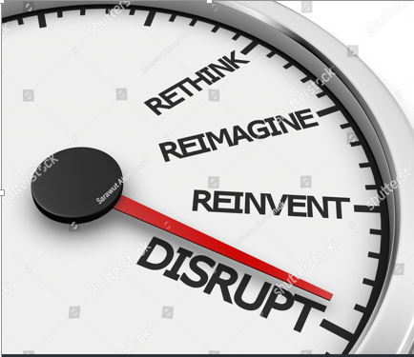
Disruptive Innovation
Turn Expensive, Difficult, Inaccessible Products and Services into Simpler and Affordable Ones
Break the Barrier,
Delight the Customers

Slide 5
Who, Why & How of Digital Entrepreneurship
To Disrupt & Delight
Customers’ Pain Point?
(Explicit & Implicit)
Gap
Present Offerings & Customers’ Pain
4 Advantage
Technology Driven 24x7
Committed & Capable Team?
To Reduce Customers’ Pain
Why New?
Why Digital?
Disruptive Power
= More with Less
Feel for
Who?
Goal?
Global Reach
Fast & Accurate
Has
Team
Start
New Business
Why Business?
More Money
Business Has?
Disruptive
Who are the Customers?
Products/ Services
Idea
High?
Why will the Customers Buy?
Has
Has
If Yes, How Much (Quantity)?
Commercial Value
@ What Price (WTP)?
Buyers/ Takers?
@ What Frequency?
How Big is the Market (Opening)?
Question is:
?
What is Your Business Plan?

Slide 6
Why Digital Entrepreneurship?
Digital Technologies are Fostering Disruptive Innovation.
Enabling Impossible as Possible: Creating Jobs and Wealth.
Digital Organizations are 26% More Profitable than their Industry Peers. (HBR)
Digital Platforms Provide Global Reach.
Velocity, Veracity/Accuracy and Ubiquity of Digital Platforms Have Made the Digital Entrepreneurship as the Foreground of Disruptive Innovation and Development.
Bangalore Has Best ICT Infrastructure and Ecosystems for Innovation, Entrepreneurship and Digital Transformation.

Slide 7
Digital Entrepreneurship is Commercialization of Disruptive Innovation

Slide 8
Lifecycle Model of Digital Entrepreneurship
Phase I
Phase II
Phase III
Driving
Disruptive Innovation
Radical
Process Innovation
Design Thinking
The Iterative Front End of Digital Entrepreneurship
Concept
Business Development
Platform
Innovation
Design Criteria
Prototype
Market Entry
Idea
Digital
Platform
Enterprise Building
Customer
Discovery
Customer
Winning
Business Model Actuation
Building STAR Teams
Realigning TEAM with Growth Strategy
Vibrant Digital
Enterprise
Product/ Service Development
Business Model Development
Fight Rivalry
Entrepreneur
Sustain Growth
Platform
Up-gradation
Fuzzy Front
End of Design
Pivoting
Digital Process
Value Optimization
Back End of Digital Entrepreneurship
Orchestration
Digital Ecosystems
S = Strategic
T = Transformational
A = Agile, and
R = Responsive
T = Task, Talents and Executive Leadership
E = Engagement and Exploration
A = Alignment and Accountability
M = Measurement and Management
Process Innovation
Source: Dr. S. K. Majumdar

Slide 9
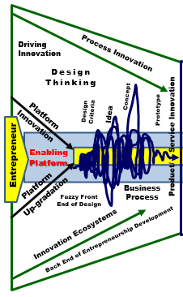
Entrepreneurship Development Lifecycle
Outcome
New Process/ Product
Phase I
Articulated By : Dr. S. K. Majumdar

Slide 10
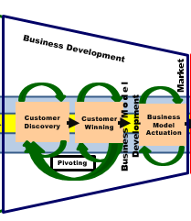
Entrepreneurship Development Lifecycle
Outcome
New Business Model
Phase II
Articulated By : Dr. S. K. Majumdar

Slide 11
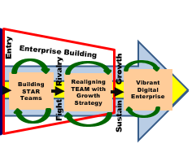
Entrepreneurship Development Lifecycle
Outcome
Phase III
S = Strategic
T = Transformational
A = Agile, and
R = Responsive
T = Task, Talents and Executive Leadership
E = Engagement and Exploration
A = Alignment and Accountability
M = Measurement and Management
Articulated By : Dr. S. K. Majumdar

Slide 12
7 Essential Abilities of Entrepreneurship
Identify an opportunity
Evaluate an idea and assess the market
Appreciate the risks and rewards of entrepreneurship
Leverage experiments to validate your idea and refine your business strategy
Discover the key financial decisions any entrepreneur must make in the early stages of a new venture
Understand the process of raising capital and how to speak to investors
Learn from successful entrepreneurs and leading venture capitalists, as well as peers

Slide 13
5 Key Questions of Entrepreneurship
What is your mission?
What are your challenges? What are your opportunities? Does the mission need to be revisited?
Who is your customer?
Who is your primary customer? Who are your supporting customers? How will your customers change?
What does the customer value?
What do you believe your primary and supporting customers’ value? What knowledge do you need to gain from your customers? How will you participate in gaining this knowledge?
What are your results?
How do you define results? Are you successful? How should you define results? What must you strengthen or abandon?
What is your business plan?
Should the mission be changed? What are your goals?

Slide 14
5 Steps of Prospect Estimation
Identify Target Customers
Quantify Market Size (in Units & in $)
Assess the Level of Competition
Estimate Risks (Probability of Success)
Estimate Probable Rewards (in $)

Slide 15
Decode Customers’ Pains
Whom is this solution going to help?
Decode the “pain points” or problems of the target customers?
How is the customer currently addressing the problem?
The Degree of Difficulties of the Present System/ Process
How can you Debug / Fix the Problem(s)/ Difficulties in an User-Friendly Way?

Slide 16
Market Size and Prospect
What is the Size of the target market?
Will the market likely to grow or decline in future?
If Yes, What is the estimated YOY Growth (%) Prospect?
What % Market Share You Plan to Attain / Capture (YOY)?
YOY = Year to Year

Slide 17
Competition /Market Structure
What are the barriers of entry for the market?
Can wall be raised to increase the barriers of entry in future to keep other entrants out?
Who dominates the market today?
Is the market fragmented or do a few big players dominate?

Slide 18
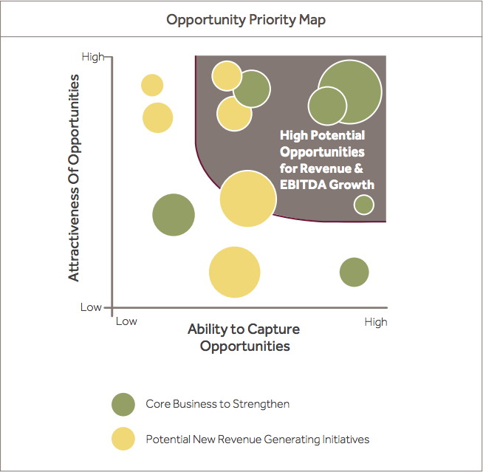
EBITDA = Earnings before interest, tax, depreciation and amortization

Slide 19
5 Steps of Target Fixation
Calculate Size of the Target Market
Decide % Market Share Wish to Capture?
Decide Desired Margin Per Unit Sold?
Compute Expected EBITDA
Estimate Probability of Success?
EBITDA = Earnings before interest, tax, depreciation and amortization

Slide 20
Size of the Target Market
Q = N x U
Q = Opportunity Size of the Target Market in Quantity
N = No. of Potential Customers in the Target Market
U = Units Consumed Per Customer Per Day/Month/Year

Slide 21
Size of the Target Market in $
S = Q x P
S = Opportunity Size of the Target Market in $ or ₹
Q = Opportunity Size of the Target Market in Quantity
P = Price (in $ or ₹) that the target customers are willing to Pay for Each Unit of Product.

Slide 22
Aspired Market Share in Quantity
Q_{A} = Q x F_{A} Units
Q_{A} = Aspired Market Share in Quantity
F_{A} = Aspired % of Market Propose to Capture

Slide 23
Value of Aspired Slice of Market in $
V_{A} = Q_{A} x P_{A}
V_{A} = Value of Aspired Slice of the Target Market in $
Q_{A} = Aspired Market Share in Quantity
P_{A} = Aspired Price for Venture’s Product in $ or ₹

Slide 24
Maximum Expected EBITDA in $
E_{MAX} = Q _{Max} x M_{A}
E_{MAX} = Maximum Expected EBITDA in $
Q _{Max} = Maximum Market Share in Quantity
M_{A} = Aspired Margin in $ or ₹ Per Unit of Sale in $ or ₹

Slide 25
Minimum Expected EBITDA in $
E_{MIN} = Q _{Min} x M_{Min}
E_{Min} = Minimum Expected EBITDA in $
Q _{Min} = Minimum Market Share in Quantity
M_{Min} = Min. Acceptable Margin Per Unit of Sale in $ or ₹
EBITDA = Earnings before interest, tax, depreciation and amortization

Slide 26
Probability of Success
P_{S} = 0.1 to 0.99
Risks are High, if P_{s} ≤ 0.5
Risks are Less if P_{s} ≥ 0.6
The Venture is Viable, if the R_{E} ≥ All Costs
R_{E} = Expected Revenue Per Annum = Q_{AQ} x P_{R}
Q_{AQ} = Actual Quantity Sold
P_{R} = Price at which each Unit was sold

Slide 27
Market Competition
MC = 0 to 1
0 = No Competition = New Product = Low Awareness
Customers are unaware of the product and its benefits and could be difficult to convince and customers might even be reluctant to try.
Probability of success is unknown (Low to High).
1 = Highly Competitive
Customers are fully aware of the product and its benefits, but might be reluctant to switch.
Strategy is differentiation.
Probability of success is difficult (Low to Medium).
Entrepreneurs and Experts might differ in their Probability Estimation. A matter personal Judgment and Gut Feelings.

Slide 28
Business Development Strategy Matrix
An Entrepreneur might Enter in a Market either with a Reinvented Product/ Service or Totally a New Product/ Service. And market might be Either an Existing Market or a New Market. This leads to 4 Different Combination and calls for 4 Different Business Development (Market Penetration) Strategy:
Market
Development of Market Infrastructure + Supply and Distribution Chains + Customer Discovery & Winning
Existing
New
Market * Development
Totally New
Customer Development
(Virgin Market)
Product
Market Expansion
Replacement
Renovated

Slide 29
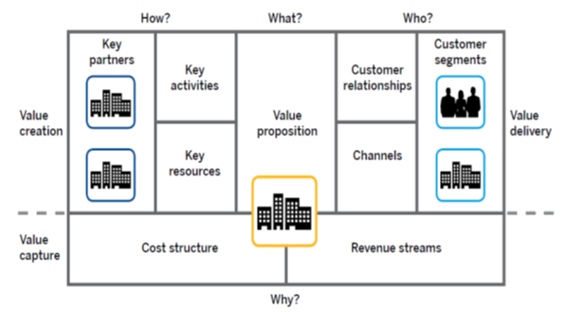

9 Blocks of Business Model Canvas
Venture Idea
The Bottom Line = Commercial Value of the Idea

Slide 30
Framework for Calculation of Market Size, Market Share and Commercial Prospects of Venture Idea
Agile Valuation Technique Requires Formulation of Multiple Hypothesis.
Specify the Market / Teritory/ Country where the Products/ Services will be offered.
Get Population and Demographic Data of the Country from Open Digital Sources.
Find the Target Customer Segment Data from the Demographic Data of the Market.
Figure out the average frequency of consumption or use of the proposed Product/ Service Per Person Per Day, Month or Year by the target customers.
Ideate the % the Target Customer most likely to Buy or Use your Offerings.
Specify the most appropriate Product Mix of your Offerings.
Assess the Value of Your Offerings w.r.t customers’ Pain and necessity and Decide the Price (MRP) of each variant of the offerings.
Decide a reasonable ₹ Margin Per Unit (MPU) of the Each Offerings.
Work out the % Customer will be Willing to Pay (WTP) for the Offerings at that Price = No. of Probable Buyers of the Offerings = Market Size of the Offerings (MSO).
Choose a % of the MSO (No. of Probable Customer of the Offerings) that you Plan to Capture YOY (Year Over Year) = % Market Share (MS)
Multiply the MSO with % of MS = Expected No. of Buyers (ENB) of your Offerings.
ENB * MRP = Expected Total Revenue (ETR).
ENB * MPU = EBTDA of the Offerings = Gross Profit
EBTDA – Tax = Net Profit

Slide 31
Exercise 1 Market Size to Revenue
Venture: A New Drinking Water Bottle For Indians
Target Market Size = 30% of 1.3 billion Indian Customers (Mainly Residents of Cities and Towns)
Everyone Need to Drinks 2 Liters of Water / Day = Q
Market Price of 1 Liter Drinking Water = ₹ 10 = P
Target Market Share = 1% of Market = F_{D}
You wish to have a Profit / Liter of Drinking Water = ₹ 1.0 or ₹ 0.50 = M_{D}
Calculate the Market Size of Bottled Drinking Water
Calculate the Size of Your Market Share in ₹
Calculate Your Expected Yearly EBITDA for ₹ 0.50 Margin Per 1 Liter Bottle.

Slide 32
Assessment Exercise Market Size to Revenue
Estimate Your Yearly Profit?
Requirement of Drinking Water for All Indians = 1.3 x 2 X 10⁹ Liters/ Day
The Market Size of Bottled Drinking Water of India = 1.3 *2 * 10⁹ * 0.3 = 2.6 * 0.30 * 10⁹ = 0.78 x 10⁹ Liters/ Day
Market Size in ₹ = 0.78 x 10⁹ * ₹ 10 = ₹ 7.8 x 10⁹ = 780 Cr./ Day
Yearly Market Size in ₹ = 780 * 30 * 12 = ₹ 2,80800 Cr. / Year
1% of Market Share 280800 Cr./ Yr. = 2808 Cr/ Yr.
Total Revenue/ Yr. = 2808 Cr./ Yr.
Your Market Share in Quantity = 2,808,000,000 Liters
Your EBITDA at ₹ 0.5 Margin/ Litter = 140.4 Cr/ Yr.
If Probability of Success = 40%
Your Risk is = 60%
1 Core = 10⁷

Slide 33
Exercise 2 Calculate Market Size and Market Share and EBITDA/ Yr.
Venture: A New Affordable Smart Mobile Phone with Solar Battery. Mobile Phone will always be on. No Recharge is required.
Target Market is India. (Residents of Cities, Towns and Villages)
30% Indian Lives in Cities and 70% in Towns and Villages.
Every Indian wish to have a Mobile Phone, but only 70% can afford it.
30% Indians’ Average Income is equivalent to an US Citizen. 40% of Indian are middle income group.
Middle income groups are very ambitious and try to follow the lifestyle of upper income groups.
You decided to launch 2 variants [Eureka X (Advanced) and Eureka – B (Basics)]
How do you wish to Price (P_{A}) the two variants of Eureka?
Calculate the Market Size (Q_{A})of “Eureka” in Quantity & ₹ based on proposed Price.
What % of Urban and Rural Market Share (F_{A}) You Propose to Capture?
Calculate the Size of Your Market Share in ₹ (V_{A}) for Eureka-X and Eureka-B
Calculate Your Expected Yearly EBITDA for ₹ 3000 Margin Per Unit of Eureka X and 2000 Per Unit of Eureka - B.

Slide 34
Exercise 3 Calculate Market Size and Market Share and EBITDA/ Yr.
Venture: An Affordable Electric Bike, ‘SuperBike’ with Solar Battery Charger. Solar Battery Charger. No electricity cost, only 2hrs of charging is required.
Target Market is India. (Residents of Cities and Towns)
30% Indian (1.2 billion) Lives in Cities and 40% in Towns.
20% of City Youth Age between 20 -36 (i.e. 40% of Urban Population) wish to have a transport of their own, but only 50% can afford it.
40% of Indian Youths Living in Indian Towns (i.e. 50% of Town Population) wish to have a transport of their own, but only 20% can afford it.
Young Indian are very ambitious like freedom of movement at affordable Costs.
You decided to launch the SuperBike in major Indian Cities and Towns
You decided to offer 30% dealership discount on MRP to your authorized dealers.
How do you wish to Price (P_{A}) the SuperBike + Solar Charger?
Calculate the Market Size (Q_{A})of “SuperBike” in Quantity & ₹ on proposed Price.
What % of Urban and Rural Market Share (F_{A}) You Propose to Capture?
Calculate the Size of Your Market Share in ₹ (V_{A}) for SuperBike – Cities and Towns
Calculate Your Expected Yearly EBITDA for ₹ 3000 Margin Per Unit of SuperBike – C for Cities and 2000 Per Unit of SuperBike – T for Towns.

Slide 35
Exercise 4
Venture: Govt. of India has banned use of Single Plastic. It is causing problem to Drinking Water Bottling Industry. You have developed a non-breakable transparent Food-Grade Silicon bottle, which can be used for multiple refill of water from drinking water Dispensers.
Target Market Size = 40% of 1.35 billion Indian Customers (Mainly Residents of Cities and Towns, Av. Family size = 5)
Every Family Needs at least three Silicon Bottles to Carry Drinking Water to school or work /Year= Q
Price of one 1 Liter Silicon Bottle = ₹ 20 = P1
Price of Pack of 3 Silicon Bottle = ₹ 50 = P2
Planned Target Market Share = 10% of Market = F_{D}
Expected Profit / Pack of 3 = ₹ 5.0 or ₹ 2.0/ Bottle = M_{D}
Calculate the Market Size of Silicon Water Bottle.
Calculate the Size of Your Market Share in ₹
Calculate Yearly EBITDA for ₹ 1.00 Margin Per 1 Liter Bottle.

Slide 36
Exercise 5
Venture: You in collaboration with IISc Bangalore and Eureka Forbes have developed a ‘Covid19-Purifier’ (CP19), which can kill 99.99% of Covid19 virus and keeps room free from Air pollution and enriches with high Oxygen content. Prototype (MVP) of the product is ready. The same has been placed for inspection and approval of ICMR’s and FDA’s. Commercial production and distribution will start soon after the receipt of ICMR’s and FDA’s approval.
ICMR = Indian Council of Medical Research; FDA = Food and Drug Administration.
Target Market Segments are Indian Shops, Malls, Restaurants, Hospitals, Hotels, Private Clinics, Public and Private Buses and Cars School and College Classrooms, Urban Residential Houses, Public and Private Offices and Public Meeting Places.
CP19 will be available in 4 sizes:
0.3 Tons for 40 SQFT closed space suitable for Small to Mid-Sized Passenger Vehicle
0.75 Tons for 100 SQFT area suitable for Small Sized Room (SSR)
1.0 Tons for 150 SQFT area suitable for Medium Sized Room (MSR)
1.5 Tons for 200 SQFT suitable for Large Sized Room (LSR).
Every mid-size Shop unit needs at least One 1.0 Ton CP19,
Every residential unit needs at least One 1.0 Ton CP19 for their drawing room (10ft x12ft). (Note: 40% of 1.40 billion Indian leave in Cities and Town. Average Family Size = 5) = Q
Every Bus requires Two (Front and Back) 1.0 Ton CP19.
Every Hotel Room Need One 0.75 Tone CP19.
Every Sigle Bedded Hospital Room need One 1.0 Ton CP19
Every Large Classroom need al least Two (Front + Back) 1.5 Ton CP19

Slide 37
Quick Google Search Reveals the Followings:
The quick Google search reveals the followings:
India has 13 million grocery outlets (shops)
India has 2.5 million Hotel Rooms
India has 2.0 million Hospital Beds
India has 0.7 million Restaurants (Organized) & 23 million in (Unorganized sector).
India has 40 million SQFT Office Space
India has 3.4 million Passenger Vehicles
India has 1.0 million Buses
India Railway has 13,500 Passenger Trains, 7,349 Stations and 120,000 Coaches.
Indian Metro Rail has 2,505 Coaches
India has 123 Commercial Airports, of which 34 are International Airports.

Slide 38
Exercise 5 … Contd
Please Do the Followings:
Calculate the Market Size of the following Market Segments:
Shops
Restaurants (400 SQFT),
Hospitals,
Hotels,
Private Clinics,
Public and Private Buses
Cars
School and College Classrooms,
Urban Residential Houses,
Large Public and Private Offices and Public Meeting Places.
Calculate the Size of Your Market Share in ₹ for all the Market Segments:
Calculate Yearly EBITDA for all the Market Segments. The Price (after trade discount) and Margin of each of 4 sizes are as follows:
# | Size of CP19 | Price | Margin
1 | 0.3 Ton for 40 SQFT | ₹15,000 | ₹ 5,000
2 | 0.75 Ton for 90 SQFT | ₹20,000 | ₹ 8,000
3 | 1.0 Ton for 120 SQFT | ₹25,000 | ₹10,000
4 | 1.5 Ton for 200 SQFT | ₹30,000 | ₹12,000

Slide 39

Question Please

